Slide 1

The impact of pedestrians on roundabout‘s entry
A simulation in the context of the lecture, Modelling and Simulating Social Systems with MATLAB

Slide 2
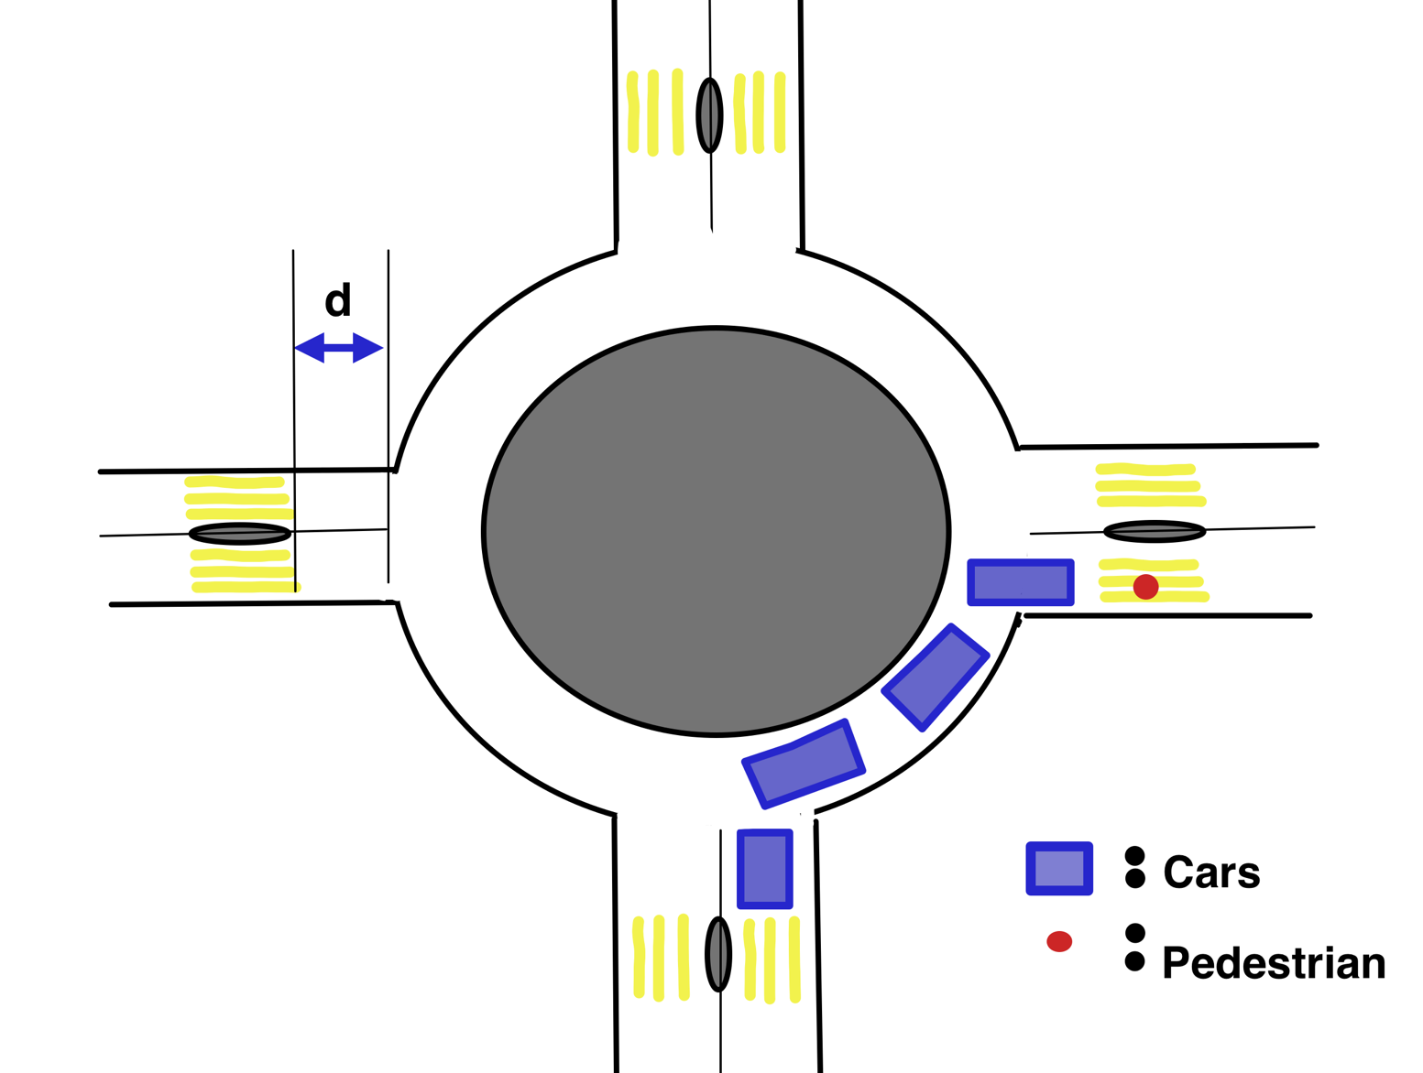
Introduction
Research Question:
Is a reasonably small increase of the storage space between the yield line and the crosswalk “n_a “ has a significant positive impact on the entry capacity “Cs” ?
n_a

Slide 3
Gap acceptance theory
Minorflow: Vehicles intending to merge into the roundabout
Majorflows: Pedestrians crossing and circulating vehicles
Entry-capacity Cs: How many vehicles can enter one accepted gap and how accepted gaps are provided
Roundabout ⬄ two unsignalized intersections to cross and merge into.
Fig. 1

Slide 4
The model
Circulation flow divided in flowing traffic (Ca) queuing traffic ( Pq)
Ca(n_a) is adjusted with f and g
f = maximum entry flow without considering pedestrians ( simple case )
g = maximum entry flow considering pedestrians but without storage space ( calculated using Queue theory )
Pq is estimated using queuing theory
Fig. 2
n_a

Slide 5
The implementation
Two different Implementations
First shows the impact of a growing n_a
Second shows the difference between n_a =1 and n_a =2 over a day.

Slide 6
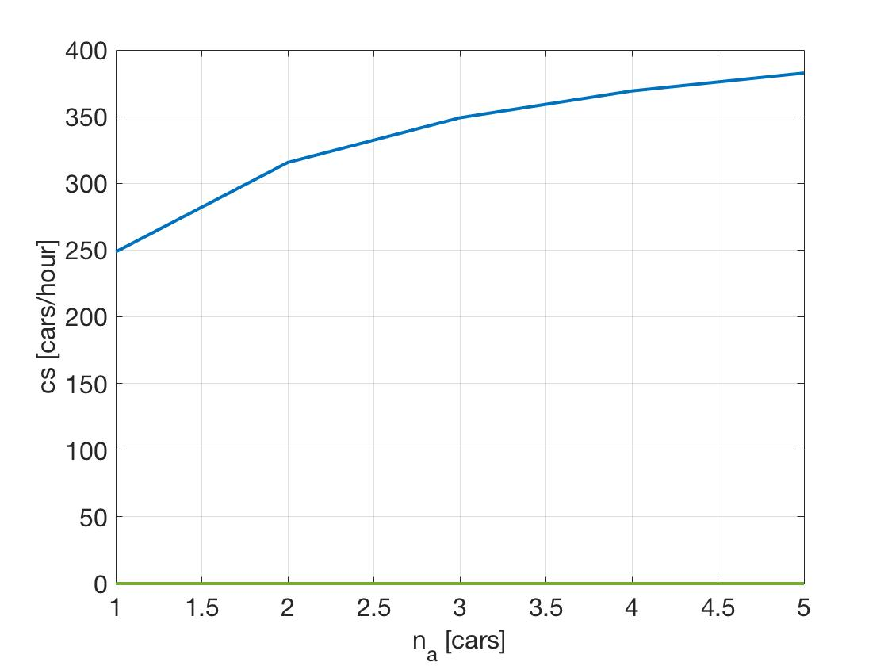
Results and Discussion
Fitting parameters because of the simplified model
Values in the same range as in the model from Dr. Eng. Nan Kang and Dr. Eng. Hideki Nakamura
A big change of cs from n_a = 1 n_a= 2

Slide 7
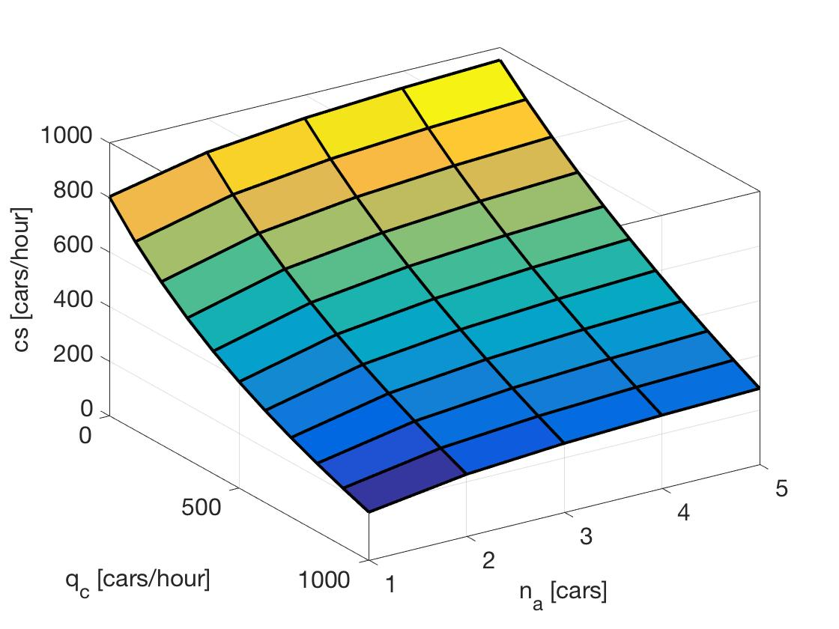
Results and Discussion
Impact of n_a remains for changing q_c
n_a = 2 is the most promising value

Slide 8
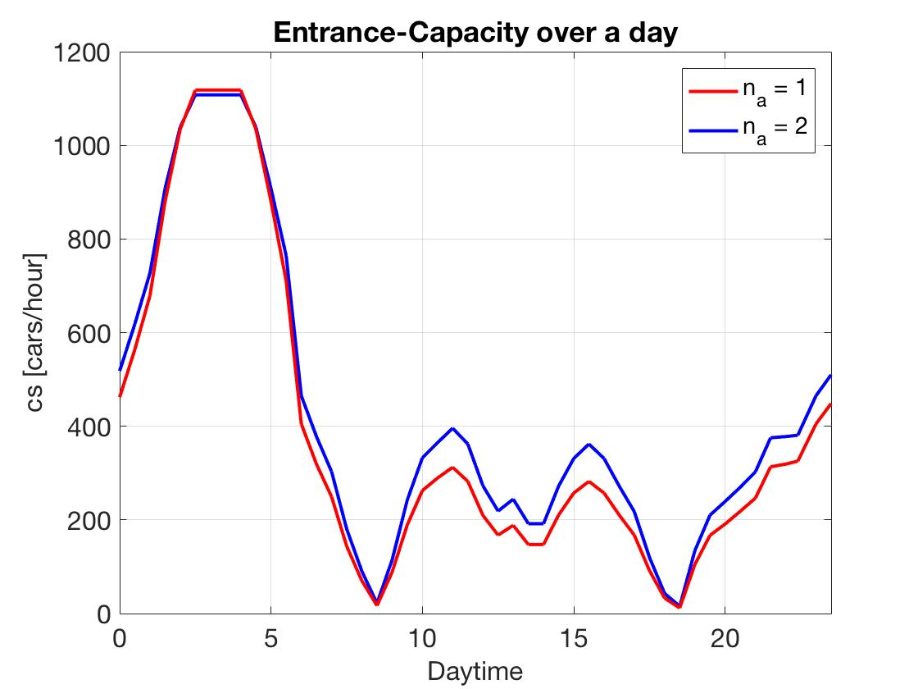
Results and Discussion
First implementation was not very accurate
q_c, q_cprime, q_p and q_pprime vary over 24 hours
Only an improvement of eleven percent over a day
Big improvement between 10am and 5pm

Slide 9
Results and Discussion
Behaves as expected
Model is highly simplified but still gives consistent results
n_a might have a big influence
Next step actual data of a roundabout

Slide 10
Conclusion
Research Question:
Is a reasonably small increase of the storage space between the yield line and the crosswalk “n_a “ has a significant positive impact on the entry capacity “Cs” ?

Slide 11
References
Fig. 1: http://ir.nul.nagoya-u.ac.jp/jspui/bitstream/2237/20517/2/10680本文.pdf
Fig. 2: http://ir.nul.nagoya-u.ac.jp/jspui/bitstream/2237/20517/2/10680本文.pdf

